Slide 1

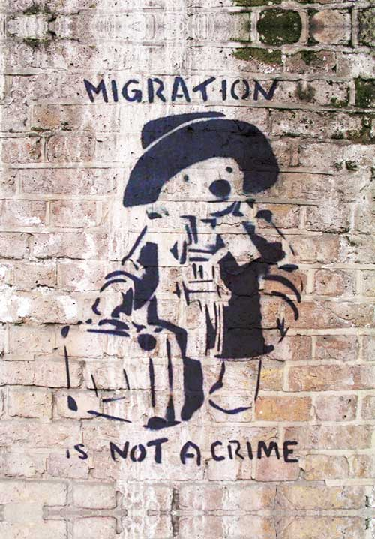
Separated and Unaccompanied Asylum Seeking Children in Scotland
Scottish Universities Insight Institute
Seminar Series
Event One 30th Nov- 1st Dec 2017
Welcome!

Slide 2
About the programme
Drawing on international and national expertise, the programme:
Focuses on the readiness of Scotland’s local and national governments, and partner agencies, to support and meet the needs of separated children and young people;
Aims to do this through an investigation of present conceptual knowledge, understanding and best practice nationally and internationally.;
Provides an opportunity to explore the various ways unaccompanied minors are framed within policy and guidance, a framing that informs understanding and responses;
Identifies existing systems in place to support and work with separated children and the policy, practice, legal and conceptual frameworks around this.

Slide 3
Two key questions
Question 1
What are the conceptual, definitional and political issues that affect understanding of the needs and motivations of children on the move?
Question 2
What knowledge and evidence underpins current responses and support for separated children?

Slide 4
Question 1
What are the conceptual, definitional and political issues that affect understanding of the needs and motivations of children on the move?
Aims
to locate the movement of unaccompanied children in a theoretical framework of global, political and economic development and local responses
to identify models of good practice that can begin to develop a common approach to inform policy and practice and further research
Objectives
to bring together a group of national and international experts from across disciplines and sectors, who have been involved in work with separated children
to learn from previous successful international developments about effective and appropriate responses and provision

Slide 5
Question 2
What knowledge and evidence underpins current responses and support for separated children?
Aims
to identify models of service provision and learning that can provide effective responses to the needs of separated children in the Scottish context
to develop a network of expertise that links Scotland into international developments and good practice
Objectives
to bring together UK and international participants who have been engaged in the development of evidence based service provision
To explore the factors that promote and hinder the development of effective support for children on the move

Slide 6
Partnership programme
Paul Rigby, University of Stirling & Daniela Sime, University of Strathclyde
Prof Ravi Kohli, University of Bedfordshire
Catriona MacSween, Scottish Guardianship System
Mirren Kelly, COSLA
Marion McCloud, Children in Scotland
Keith Moore-Milne, GCC
Judit Almasi, Terre des Homme

Slide 7
context
Department of Education (2017) Safeguarding Strategy
“Our aspiration is that all unaccompanied children have access to the care, services and support they need, with a more equal distribution of caring responsibilities across the UK. This means no one local authority should be caring for a disproportionate number of unaccompanied children. We want every local authority to feel capable of supporting their welfare needs, with professionals in place with the right skills, training and experience to deliver high quality care. And we want to ensure that children have access to high quality placements and support that meets their needs and helps them fulfil their long-term potential – whether their future is in the UK or elsewhere.”

Slide 8
safeguarding strategy (2017)
“An unaccompanied asylum seeking child is defined as an individual who is:
under 18 years of age when the claim is submitted;
applying for asylum in their own right;
separated from both parents and is not being cared for by an adult who in law or by custom has responsibility to do so. “
Gives the following figures:
160,000 UASCs in Europe in 2015-2016
6,000 claimed asylum in UK (4% of all claims in EU)
4,560 UASCs currently in system (out of 72,670 looked after by LAs)
22% aged under 16; 78% aged 16+

Slide 9
context
Note strategy does not commit to a number of UASCs the UK will receive
‘The Government is clear about our moral responsibility to assist those who are suffering as a result of world conflict. There are safe, legal routes by which people, including children, in need of international protection can be resettled in the UK, thereby avoiding people risking their lives by making dangerous journeys to Europe. These include the Gateway and Mandate schemes as well as the Vulnerable Person’s Scheme, of which around 50% of people resettled will be children, and the Vulnerable Children’s Resettlement schemes. We will resettle over 23,000 people by 2020.’
Clear anti-immigration rhetoric post-Brexit, intention to leave the EU also likely to mean withdrawal from agreements of resettlement of refugees

Slide 10
The Scottish context
Whilst immigration and asylum is a reserved matter for the UK Government, child protection and children’s social care is devolved
Scotland has clear commitment to UASCs, but less control over which children and young people come to Scotland- or how many come
Some experience, but numbers are small

Slide 11
Programme – day 1
Morning
10.45 – 11.30 Andy Sirel, Just Right Scotland – Legislation and human rights
11.45 – 12.30 Mirren Kelly, Cosla – What’s happening in Scotland
12.30 – 1.15 Open questions / table discussion
1.15 - 2.15pm lunch
Afternoon
2.15 – 3.00 Young people – ‘our experience’
3.00 – 3.45 Foster carers – ‘our experience’
3.45 – 4.30 Catriona MacSween, Scottish Guardianship Service
4.30 – 5.00 Discussion / questions

